Slide 1
First Step to Success
An Early Intervention Program for Young Children with Challenging Behaviors
Instructor:
Annemieke Golly, Ph.D.,
agolly@uoregon.edu
(541) 344-7784
Oregon Research Institute

Slide 2
Agenda
9:00 – 9:30 Introductions
9:30 – 12:00 Positive, proactive strategies for ALL kids
12:00 – 1:00 Lunch
1:00 – 3:15 First Step to Success
3:15 – 3:30 Focus group and wrap-up.

Slide 3
What helps Mark
Organization
Clear Expectations
Adequate sleep
Regular and healthy meals
Excercise
Humor
A Hobbie (working with horses)

Slide 4
3-5%
FEW
(High Risk)
Individual
Interventions
Functional Assessment
Individual Behavior Management Plans
Parent Training and Collaboration
Multi-agency collaboration (wrap-around)
PMTO
7-10%
SOME
(At-Risk Students)
Classroom and Small Group Strategies
Intensive social skills teaching
First Step to Success
Adult mentors (checking in)
Increased academic support
85-90%
ALL
(All Students)
School-Wide Systems of Support
Social skills teaching
Positive, proactive discipline
Teaching social behavior
expectations
Active supervision and monitoring
Positive reinforcement systems
Firm, fair, and corrective discipline
Data-based decision making
P. 27

Slide 5
SCHOOLWIDE EXPECTATIONS
Define school rules in ALL settings
Agree on rules with ENTIRE staff
Teach expectations to ALL students
Positively reinforce students following the rules
Encourage the behavior you want
Develop consequences for not following the rules

Slide 8
What’s First Step to Success?
Helps young students adjust to school.
Improves children’s social adjustment and school performance.
Enlists help of three most important people in the life of a child:
    Family
    Teachers
    Peers

Slide 9
Why First Step to Success?
Research shows that the earlier intervention occurs, the more likely it is that positive outcomes will be achieved.
First Step to Success is an evidence-based program shown to reduce frequency of antisocial behavior and to increase school readiness among young children.

Slide 10
What are its primary goals?
Teach children to get along with others at school (teachers and peers).
Teach children how to focus and complete tasks.

Slide 11
Where does it take place?
In the classroom – takes about 30 days to complete
In the home – six one-hour weekly visits

Slide 13
How is it done in the classroom?
First Step Coach role-plays and teaches child expected behaviors.
When child is ready, he/she “plays the Green/Red Card game” with peers.
Child earns special activities for entire class.
Parents receive daily feedback.
Teachers take over and continue the approach.

Slide 14
What is done in the home?
Six one-hour weekly visits by the coach.
Coach teaches family fun and supportive activities designed to help the child succeed in school.
Parents or caregivers are encouraged to do the activities a few minutes each day with the child.

Slide 16
How do we know it works?
Program received 20 Million Dollars Research grants during the past decade
Recognized as a model program by:
  Substance Abuse and Mental Health Services Administration (SAMHSA) –
  Prevention Research Center – Pennsylvania State University
  University of Colorado – Center for the Study and Prevention of Violence

Slide 17
What outcomes are expected?
Improved social behaviors
Improved educational outcomes
(early literacy skills)
Improved child-family interactions

Slide 18
How are outcomes measured?
ESP Adaptive Behavior Scale
ESP Maladaptive Behavior Scale
Aggressive subscale of Child Behavior Checklist
AET Observations using a stop watch
Woodcock-Johnson III (growth curve analysis)

Slide 21
Outcome for Class as a Whole
“Did the First Step program have an effect on the behavior of your class as a whole?”
1-Very negative effect , 2- Negative effect, 3 – No effect, 4-Positive Effect, 5- Very positive effect.
Teachers from Washington County reported that as a result of The First Step to Success Intervention…
class behavior improved
in 198 out of 221 classrooms (91%)
These teachers rated this question either a 4 or a 5 On the scale above

Slide 22


Slide 23
In order for the child to change their behavior, the adults must change their interactions with the child first.

Slide 24
Be Consistent with Expectations
If you expect students to raise their hand quietly…Only call on students who raise their hand. Do not respond to talk outs.
If you expect students to work quietly, reinforce the students who are working quietly.

Slide 25
X-Activity
Pick a partner or get into groups of 4.
Identify one area in your classroom that needs improvement.
DO NOT commit ASSUMESIDE (Anita Archer)!
What do you want to see and/or hear instead?
How will you teach this expectation?
What kind of motivator will you use?

Slide 26
What can be done??
Establish Clear Expectations for the Group
Imagine your ideal
group.…
  - What do you want to see?
  - What do you want to hear?

Slide 27
Examples of Clear Expectations:
Follow directions the first time given
Move carefully, quickly and quietly
Raise your hand for permission to speak
Keep hands, feet and objects to self

Slide 29
Why do most children misbehave?
Attention (adult, peer)
Avoidance (Task too hard, too easy, boring)

Slide 30
What Can We Do?
Motivate All Students
Provide lots of positive feedback
Minimize attention for minor inappropriate behavior
Focus on the behavior you want
Use humor, never sarcasm.
Have fun!

Slide 31
Activity
Think of a student who is a weak or non-responder in your classroom/group
What “need” (attention, avoidance) is maintaining the inappropriate behavior meeting for the student.
How do you typically deal with the student when unacceptable behavior occurs.
How might your behavior maintain the problem behavior?

Slide 32
Motivation
If the student can’t do the task, it’s a skill problem. You have to teach or re-teach!
If the student won’t do the task, it’s a motivational problem. You have to motivate!
In both cases, you have to change your behavior.
It is your job to help the student be as successful as possible!

Slide 33
Motivation
Make separate chart with 2 columns
You/ Other (make believe animal or object)
When they are doing the “right thing” they get a point
When someone isn’t doing “the right thing”, the other side gets a point.
YOU | (e.g. Snoopy Sponge Bob Mr. President)

Slide 34
If they have more points then the other side at the end of the period, they get a mark on the motivational chart
When motivational chart is filled, there is a surprise for the entire class.
YOU IIIII IIIII | Snoopy I

Slide 35
Motivation
This game is an excellent way to keep data on your positive interactions with the kids.
Students should have at least 5 points for every point the other side gets
If not….
  Your instructions aren’t clear or..
  You are paying too much attention to inappropriate behavior.
YOU (students) lllll lllll lllll | Snoopy (other side) lllll lllll lll

Slide 36
Motivation
Pick a motivational theme (e.g., rocket, thermometer, tree, basketball, map, ladybug, butterfly)
Make a large poster with 10-20 marks
Explain how students can earn a mark (e.g., when they have more points than the other side)
Make it fun!

Slide 37
Motivation
Students can earn points for :
  Following directions
  Working independently
  Raising their hand quietly
  Lining up quickly & quietly
  Cleaning up quickly & quietly
  Transitioning quickly & quietly
  Etc.

Slide 39
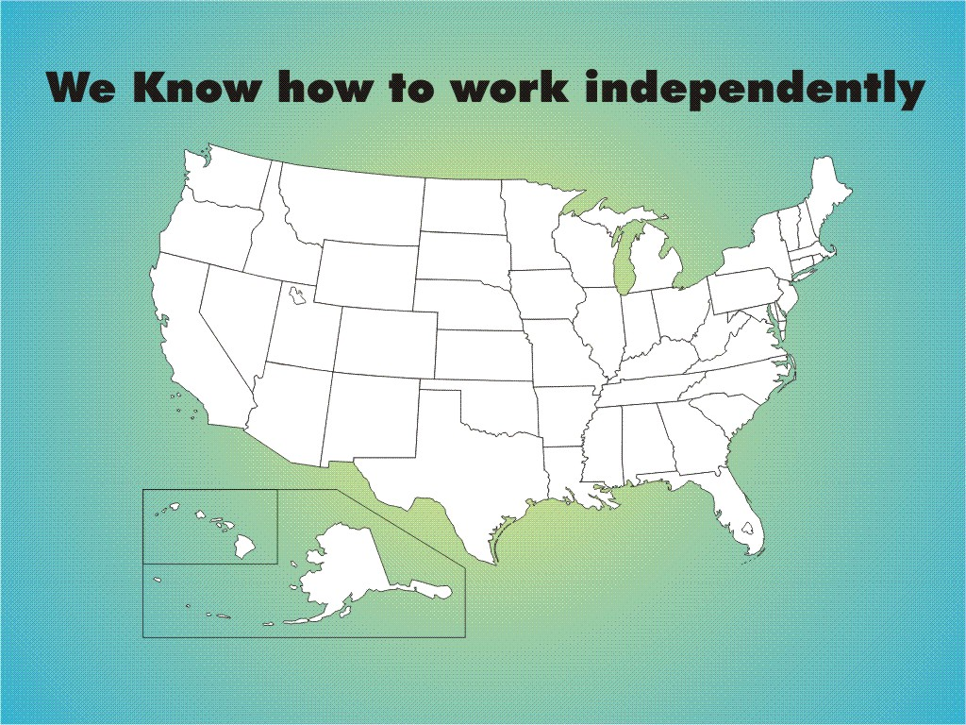

Slide 40
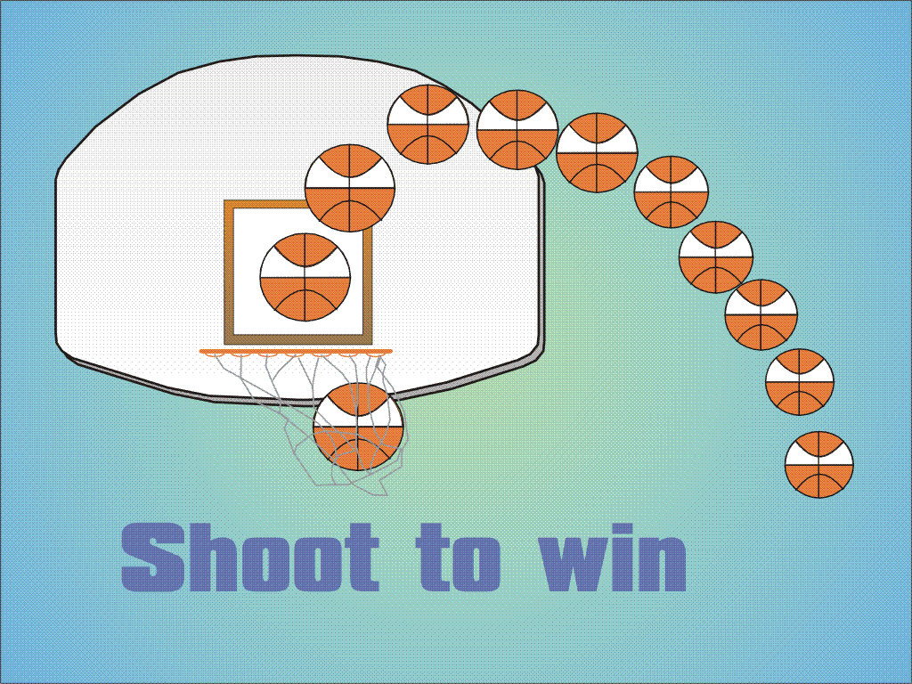
“We know how to be respectful!”

Slide 41
Identify the Problem
Put it in observable & teachable terms..
  Say:
  “ I need to teach them how to transition quickly and quietly.”
  Not “They should know how to play.”
  Do not commit “Assumeside!”

Slide 42
Basic Concept
Decide what you want to see and hear
Tell students what you want
Teach students what you want
Reinforce them a lot when they are doing it
Minimize a “lot of attention” when they’re not doing it

Slide 43
Pro-active vs.Re-active Adults
Re-active adults deal with problem behaviors
Pro-active adults prevent problem behaviors
Turn to the person next to you and give an example of being re-active
Turn to the person on your other side and give an example of being pro- active

Slide 44
Punish
Reduce reliance on punishment, time-out, office-referral and suspension, as a primary strategy
If the “punished” behavior occurs again and again, the punisher is reinforcing to the child.
Find out what the child is trying to get (e.g., attention, avoidance/escape or both).

Slide 45
Reactive Statements
  What are you doing!?
  Stop that!
  Sit down!
  Get to work!
  No!
  You should know how to do that by now!
  Many times our reactive statements increase anger and escalate behavior.

Slide 46
Verbal & Non-verbal Communication
Be aware of your communication style
Videotape yourself and watch for:
  Shaking finger?
  Hands in sides?
  Standing in front of the student.
  Looking down at the student.
  Being at eyelevel with the student?
  Giving the student a clear direction?

Slide 47
Pro-active/Reinforcing words:
“ I noticed……”
“I saw…..”
“You are being responsible, respectful, safe when you…….”

Slide 48
Proactive Statements
Focus on the desired behavior, not on the misbehavior.
  In see you are getting started on your work.
  I noticed you lined up quietly.
  I see you are sitting quietly.
  I see you are waiting for directions.
  I see you have your hands folded, thank you for showing me respect.

Slide 49
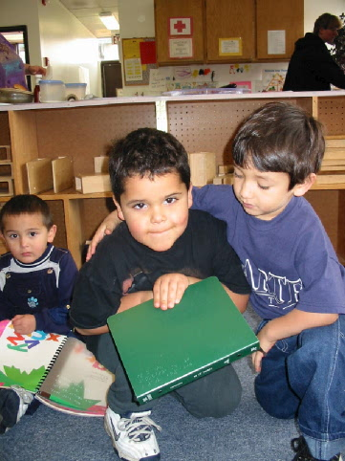
Dealing with problem behavior
Stay calm
Be specific
Use a neutral tone
Avoid a power struggle!

Slide 50
Helpful words:
To Encourage & Reinforce:
“I noticed…..” & “I saw…..”
“Can I help you?”
To stay out of a power struggle:
“Regardless “
“Never the Less”

Slide 51
What else…..
Do NOT hold a grudge!
Use humor, not sarcasm
Always treat the child with respect.

Slide 52
What can be done?
Be organized
Set up a positive and predictable classroom environment
Develop and teach clear expectations

Slide 53
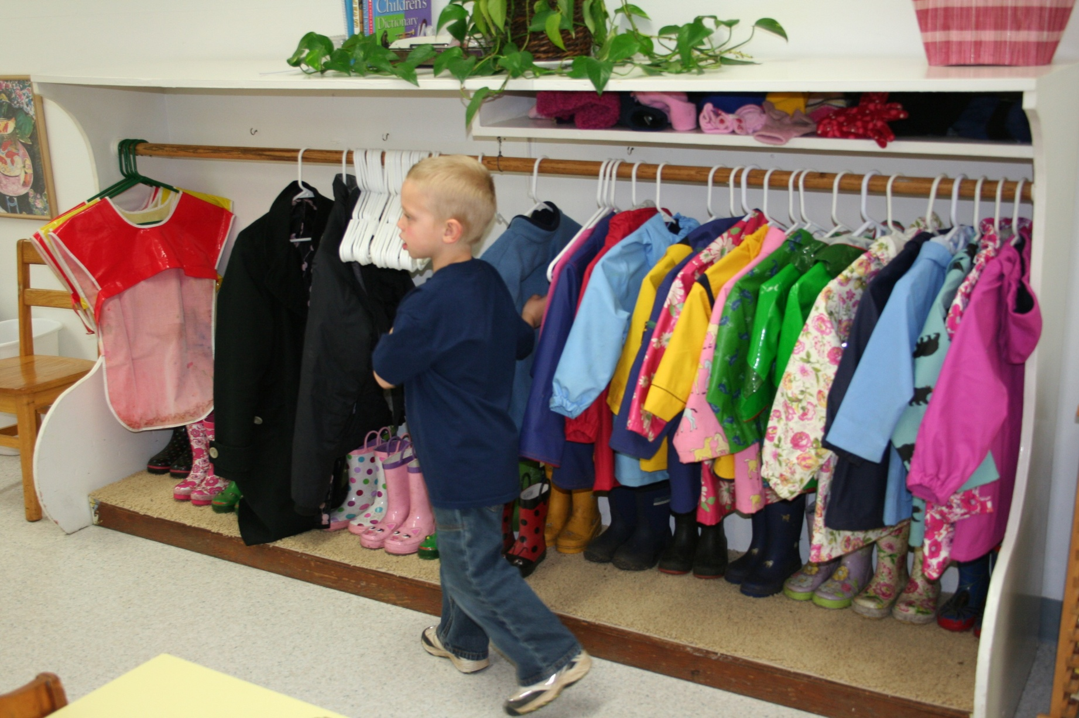
Classroom Organization
Kids are taught to hang up coats and place boots

Slide 54
Neatness and Organization
Teach students:
  respect for their space
    Coats on hangers, hats off, roll up sleeves
    Put materials away neatly
  Personal space
    Walk with personal space around you
    Stand in line with personal space
    Walk with a purpose

Slide 55
Response to Intervention
If you are doing the same thing again and again and the behavior doesn’t change, you must change your intervention/interaction.
The teacher always has to change first before the child will change!

Slide 56
Use Data-based Decisions
Keep track of repeat “offenders”
  E.g., turning card, name on board, send to office, call parents.
  The “punishment” actually maybe reinforcing for the student.

Slide 57
What can be done?
Encourage the Child
Recognize effort not just success
Provide warmth, caring and
Frequent encouragement
Lots of positive feedback
Minimize reprimands

Slide 58
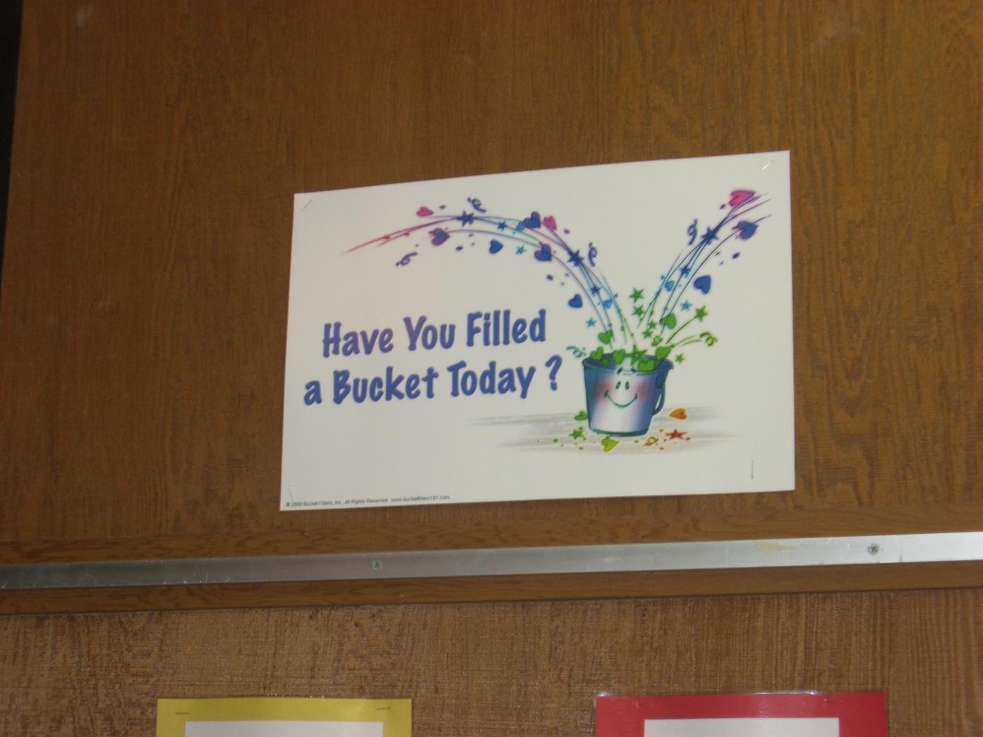
Make sure the “Attention Bucket” is full!

Slide 59
In spite of the best classroom management, some children need more….
First Step to Success provides more for students, teachers and parents.

Slide 61
Definition of Antisocial
Actions that deviate from accepted rules and behavioral expectations
ACROSS A RANGE OF
SETTINGS
including classroom and playground
  Includes disruptive, aggressive, and noncompliant behaviors

Slide 62
Characteristics of Problem Behaviors
Antisocial behavior is part of normal development
Crucial features are the
FREQUENCY
and
INTENSITY
of behaviors

Slide 63
Characteristics of Problem Behaviors
Less “time-on-task”
More negative interactions with parents, siblings, teachers, and peers
Peer rejection

Slide 64
Characteristics of the Child
Temperamental
Oppositional
Impulsive
Attention Deficit Problems

Slide 65
Facts on Antisocial Behavior
Antisocial behavior by grade 4 should be treated as chronic condition like diabetes (not cured but managed)
Early intervention in school, home, and community is best hope for diverting from the path

Slide 66
Stressors
Frequently cited reasons:
Low Income
Unemployment
Marital Problems
Emotional/Physical Abuse

Slide 68


Slide 69
Parents/Caregivers/Teachers
Reasons:
Ineffective (inconsistent) discipline
Harsh discipline
Lack of positive interactions
Lack of monitoring

Slide 70
CLASS INTERVENTION:
Positive behavior management program
Children learn how to:
  Attend to the teacher
  Get along with others
  Participate in activities

Slide 71
CLASS Procedures:
One student at a time plays the GREEN/RED card game
GREEN/RED card provides feedback
Stars on GREEN
side earn surprise
for the class

Slide 72
First Step to Success Kit
All materials needed for implementation are included
  Implementation Guide
  Stopwatch
  HomeBase Guide
  3 sets of parent materials
  3 sets of classroom materials
  Training video
  First Step to Success Roadmap

Slide 74
COACH’S ROLE:
Observes the target student
Meets with caregiver and teacher
Provides materials
Teaches acceptable behavior 1-1

Slide 75
PLAYING THE GREEN/RED CARD GAME
Procedures (continued)
  Teacher teaches, coach operates card
  When time is up, debrief with student
  Ask teacher to stop class
  Announce the outcome

Slide 76
COACH’S ROLE (cont.)
Introduces game to the class
Operates the GREEN/RED card first 5 days
Announces surprise to the class
Sends GREEN/RED card home
Contacts parents each day first 5 days
Supports teacher
Starts homeBase after day 5
Conducts homeBase 6 weeks for 1 hour

Slide 78
TEACHER’S ROLE (Continued)
Communicates with coach
Communicates with caregiver at least once a week
Catches the child ”doing the right thing” for remainder of the year
Avoids power struggle

Slide 80
CARETAKER’S ROLE:
Provides encouragement and surprises
Signs GREEN/RED card every day
Participates in weekly homeBase meetings

Slide 81
CARETAKER’S ROLE (Continued)
Practices homeBase parenting tips
Plays homeBase games with child for 5 minutes each day
Communicates with coach and/or teacher

Slide 82
CHILD’S ROLE:
Agrees to participate
Brings home GREEN/RED card
Chooses “surprises” for the class
Participates in homeBase activities

Slide 83
PEERS’ ROLE:
Follow teacher directions
Do own work
Ignore minor misbehaviors
Encourage target student for playing GREEN/REDcard game well
Thank target student for earning a surprise for the class

Slide 84
ADDITIONAL SCHOOL STAFF’S ROLE:
Catch The child “doing the right thing”
Avoid excessive attention for inappropriate behaviors
Be clear and direct
Always use a neutral tone
Avoid “power struggles!”
Support the teacher
Notify teacher/caregiver when things are going well

Slide 85
PLAYING THE GREEN/RED CARD GAME
Procedures for first few days:
  Remind all students of expected behaviors
  Review expectations briefly with target student
  Sit near student
  Provide feedback & give points

Slide 86
PLAYING THE GREEN/RED CARD GAME
Procedures (continued)
  Teacher teaches, coach operates card
  When time is up, debrief with student
  Ask teacher to stop class
  Announce the outcome

Slide 87
hOMEBASE
Commitment for parents/caregivers:
  Weekly meetings with First Step coach: 30-45 minutes
    Complete Check-up lists (How well do you know your child ?)
    Discuss Parent Tips (Do’s and don’ts of good parenting)
    Practice Games to play with child( Focussed on school success)
  Daily practice and activities with child: 5-10 minutes

Slide 88
hOMEBASE
WEEK 1: Sharing the day
  Child practices giving information
  Parent listens and gives encouragement
  Information gives parents the power to help children be successful outside the home

Slide 89
hOMEBASE
WEEK 2: Cooperation
  Parent & child learn strategies
  Sticker chart or chart used at home
    Being cooperative allows a child opportunities to avoid problems

Slide 90
hOMEBASE
WEEK 3: Limit Setting
  Giving effective directions and encouragement
  Time-out procedures
    Teaching children to follow limits at home leads to self-control and accepting limits outside of home.

Slide 91
hOMEBASE
WEEK 4: Problem solving
  Problem-solving: stay calm and brainstorm
  Parent helps to guide, encourage, and suggest steps to goal
    Children who see problems as opportunities rather than obstacles feel capable

Slide 92
hOMEBASE
WEEK 5: Friendship skills
  Initiation skills
  Empathy and self-control
  Cooperation
    Learning friendship skills now provides a base for friendship throughout life

Slide 93
hOMEBASE
WEEK 6: Confidence building
  Confidence building
    Self-confidence developed at home provides a foundation for success outside the home.

